Slide 1



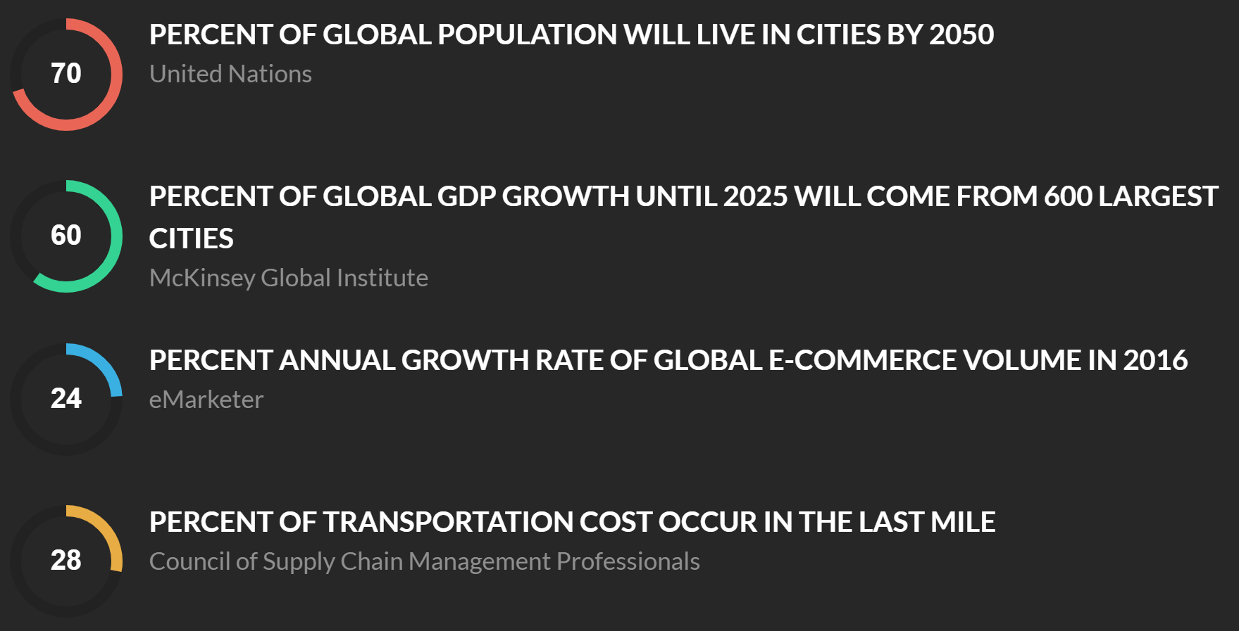
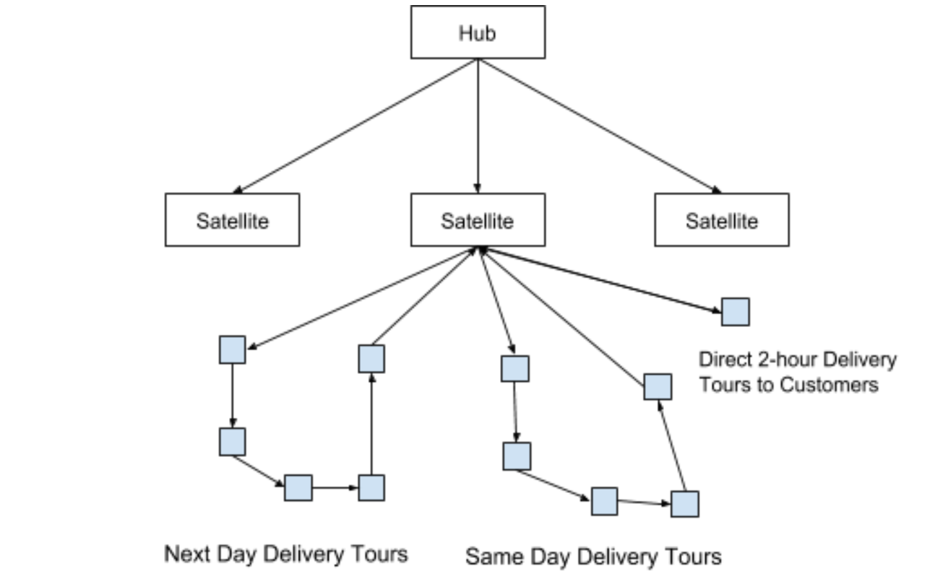


Modeling Large Scale eCommerce Distribution Networks
Student: Nelson Calero, SCM 2019
Student: Yao Zhang, SCM 2019
Advisor: Dr. Milena Janjevic
Sponsor: MIT Megacity Logistics Lab
January 2019 Poster Session
Key Questions
Methodology
To integrate location, routing, and inventory control decisions in designing a multi-echelon distribution network for e-commerce. Key questions to answer:
Which satellite locations should be activated and in what types, namely transshipment center or distribution center or both?
How do we allocate demand segments to satellite facilities?
Where should we locate inventory, in what quantity and what frequency for replenishment?
We will formulate the problem as a mixed-integer linear programming model based on the continuum approximation method of Winkenbach et al. (2016) and Merchan and Winkenbach (2018). The entire demand area under consideration will be divided into very small demand segments and each demand segment is considered in its entirety. We will also introduce inventory control decisions to the model to determine the inventory holding level and ordering frequency of each satellite facility.
Model Formulation
Motivation / Background
min: K_{C}^{H} handling cost at central distribution hub
+ K^{F} fixed cost of enabling satellite facilities
+ K_{S}^{H} handling cost at each satellite facility
+ K^{IH} inventory holding cost at each satellite facility
+ K^{IO} inventory ordering cost at each satellite facility
+ K^{T} transportation cost from central to satellite
+ K^{D} routing cost from satellite facilities to demand segments
Constraints:
All demand segments and all delivery of different types must be serviced, and by only one satellite facility
Allocation of segments is restricted to active satellite facilities
Total volume assigned to each satellite facility is within its capacity
The Problem
A large e-commerce company in Brazil offers three types of delivery service (same day, next day, and instant deliveries) to thousands of customers in a major metropolitan area in Brazil, through a central distribution center, multiple satellite locations, and different vehicles. Each satellite location can function as a transshipment center, or a distribution center, or both.
Source: http://megacitylab.mit.edu/
Expected Contribution
Relevant Literature
A framework that companies can use to solve large and complex distribution network problems effectively.
Managerial insights for companies to best service end consumers with increasingly faster and reliable expectations for deliveries.
Winkenbach, M., Kleindorfer, P. R., & Spinler, S. (2016). Enabling Urban Logistics Services at La Poste through Multi-Echelon Location-Routing. Transportation Science, 50(2), 520–540.
Merchan, D., & Winkenbach, M. (2018). High‐Resolution Last‐Mile Network Design. In E. T. E. Thompson (Ed.), City Logistics 3: Towards Sustainable and Liveable Cities (p. 201).
Nelson Calero
Yao Zhang

